Slide 1
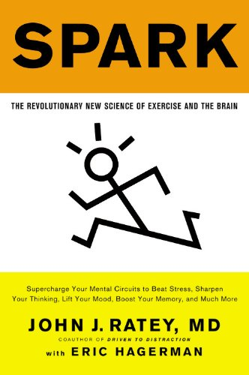
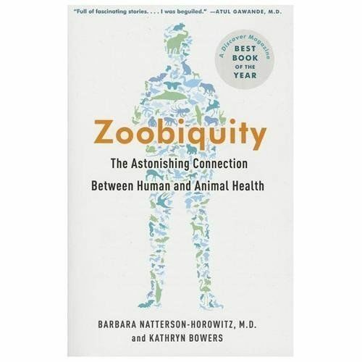
Extra credit opportunity #4 – More reading!
I will bribe you to read 2 chapters related to health behaviors from books that I enjoyed
https://sites.google.com/site/psy89articles/articles
You will choose 2 chapters from the options to read & then:
    Write an original summary describing each chapter
    Write 5 original reaction points to each chapter. Be sure to explain your reasoning.
  Worth 1 point
  (you can earn up to 2 points total)
  I was shocked that … because …
  I had a hard time buying the part about … because…
  I want to know more about … because…
  Knowing … is incredibly useful because…

